Slide 1
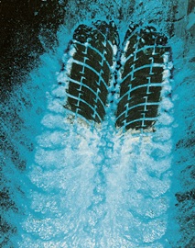
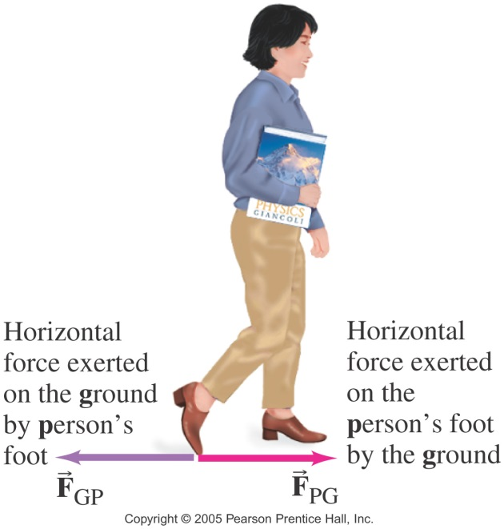
Chap 5.1 Friction
There are situations where friction helps us and at other times it is a hindrance.
Advantages of friction:
Disadvantages of friction: wear and tear & energy loss.

Slide 2
Friction in
Knee Joints
The ends of the bones in the joint are covered by cartilage. The joints also produce a
fluid (synovial fluid) that reduces friction and wear.
A damaged or arthritic joint can be replaced by an artificial joint, with very small coefficient of friction.

Slide 3
Microscopic view of
Frictional Forces

Slide 4
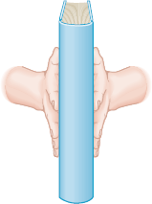
Microscopic view of
Normal Forces
Larger normal force provides a larger frictional force.

Slide 5
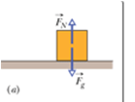
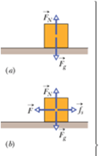
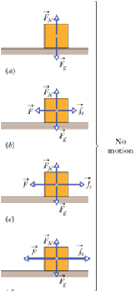
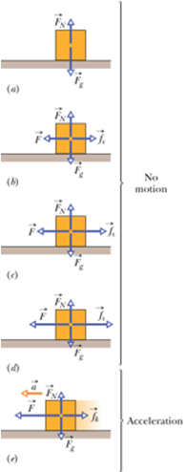
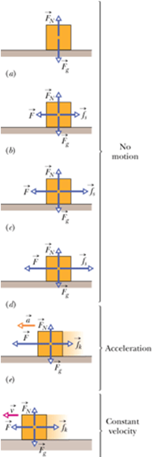
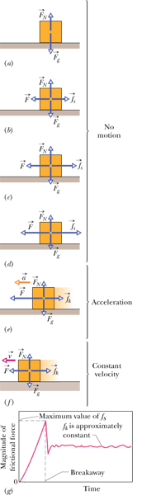
Frictional Forces
Magnitude of the maximum static frictional force is given by:
Magnitude of the kinetic frictional force is given by:

Slide 6
Example 5.1
A skier with a mass of 62 kg is sliding down a snowy slope. Find the coefficient of kinetic friction for the skier if the frictional force is known to be 45.0 N.

Slide 7
Worker on a Roof
A worker stands still on a roof sloped at an angle of 36 degrees above the horizontal. He is prevented from slipping by a static frictional force of 390 N. Find the mass of the worker.

Slide 8
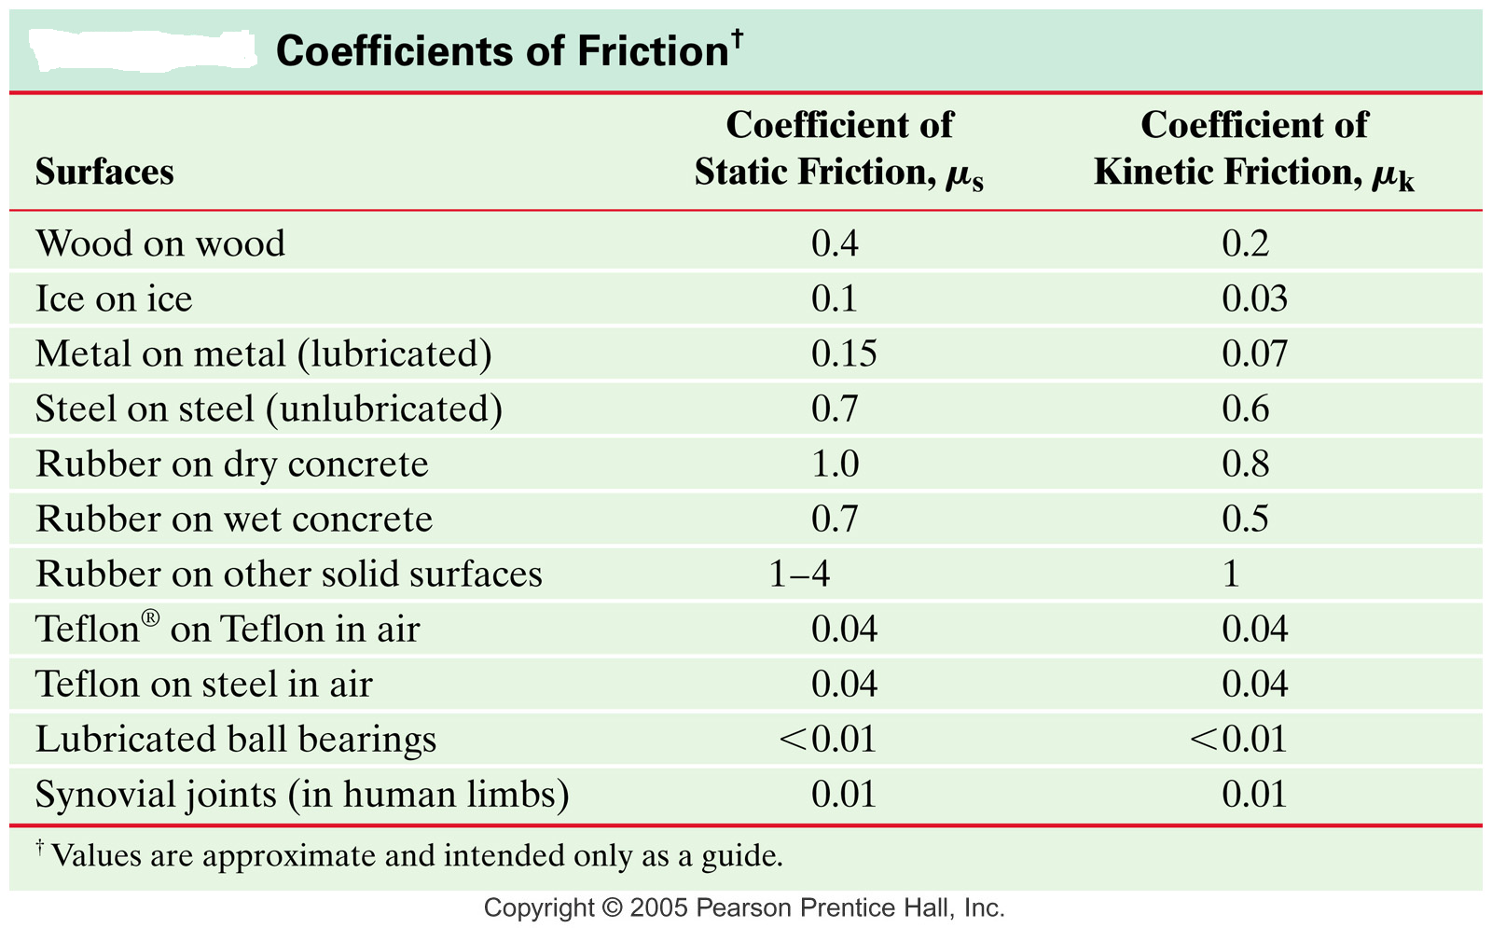
Coefficients of Friction

Slide 9
P4, Chap 5, OpenStax
4. Suppose you have a 120-kg wooden crate resting on a wood floor. (a) What maximum force can you exert horizontally on the crate without moving it? (b) If you continue to exert this force once the crate starts to slip, what will its acceleration then be?

Slide 10
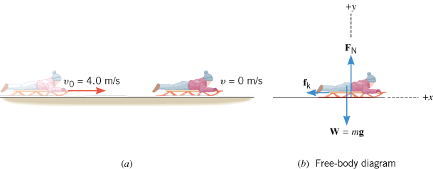
Sled Riding
A sled is traveling at 4.00 m/s along a horizontal stretch of snow, as Figure 4.23a illustrates. The coefficient of kinetic friction is μ_{k} = 0.0500. How far does the sled go before stopping?

Slide 11
Minimizing Drag for Swimmers
Body suits, such as this LZR Racer Suit, have been credited with many world records after their release in 2008. Smoother “skin” and more compression forces on a swimmer’s body provide at least 10% less drag.

Slide 12
Why geese fly in a V formation during their long migratory travels?
This shape reduces drag and energy consumption for individual birds, and also allows them a better way to communicate.

Slide 13
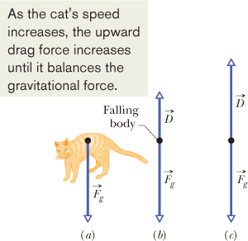
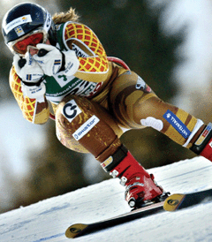
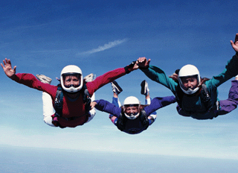
The Drag Force, D and Terminal Speed,
v_{t}
This skier crouches in an “egg position” so as to minimize her effective cross-sectional area and thus minimize the air drag acting on her.
Sky divers in a horizontal “spread eagle” maximize air drag.
Problem: What is the terminal speed of a 6.00 kg spherical ball that has a radius of 3.00 cm and a drag coefficient of 1.60? The density of the air through which the ball falls is 1.20 kg/m³.

